Slide 1
Lesson 5 - CSS Select by Class
Mr Mack 2019

Slide 2
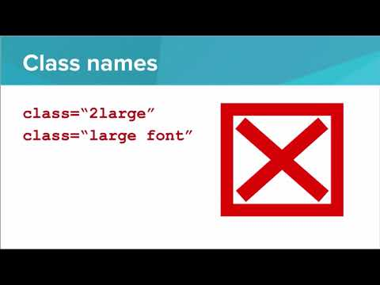

Slide 3
Which of the following code snippets will select all HTML elements with the class “alert” and set their color to be red?
alert {
color: red;
}
.alert {
color: red;
}
#alert {
color: red;
}
class="alert" {
color: red;
}

Slide 4
Example: Simple Checkerboard
This is an example for this lesson. You are encouraged to play around with it, run and change the code, and learn how it works. When you are done, click continue to go to the next problem.

Slide 5
Exercise 3.3.4: Swim Meet
The given web page shows the results of a 100 meter swim time trial. Each student’s name, time, and place is given in the table.
Add a class winner to the winning person’s row in the table, then use CSS to make the background of the winner class “Aqua”.

Slide 6
Exercise 3.3.5: Favorite Things
STARTER CODE
Copy the code from the Table of Favorites exercise
As you know, there is no styling on the current table!
YOUR JOB
Use CSS to make your Table of Favorites easier to read.
Add a “header” class to the first row
Style that class to have:
A background color of OliveDrab
A text color of white
A text-align of center
Add a “odd-row” class to the odd rows (first, third, fifth, etc)
Note we are considering odd and even data rows and ignoring the header row for this purpose.
Style that class so that the background is SandyBrown
Add a “even-row” class to the even rows (second, fourth, etc)
Style that class so that the background is IndianRed
Add this rule to your styles:
table {
width: 100%;
font-family: Helvetica;
}

Slide 7
Exercise 3.3.6: Endangered Animals: Add Color Coding
Copy over the HTML for the Endangered Animals webpage you started
Add a Class to the “Endangered” or “Threatened” List Items
Under each animal, the second list item should state whether the animal is “Endangered” or “Threatened”.
Give the list items that say “Endangered” the class endangered. Give the list items that say “Threatened” the class threatened.
Add a Class to the Scientific Name List Item
One of the other list items should have the scientific name of the animal.
Give that list item the class scientific-name.
Add Styles to the Classes
Then, add a CSS rule for the classes endangered, threatened, and scientific-name.
Make the font color for endangered red.
Make the font color for threatened OrangeRed.
Make the font style for scientific-name italic.
The result should be that the word “Endangered” will be red, the word “Threatened” will be a lighter red, and the scientific names will be italicized

